Slide 1



JABATAN PEMBANGUNAN KEMAHIRAN
KEMENTERIAN SUMBER MANUSIA
TAKLIMAT PANDUAN PELAKSANAAN
STANDARD KOMPETENSI KEBANGSAAN (SKK) –
CORE ABILITIES Z-009:2015
TAKLIMAT PANDUAN PELAKSANAAN
STANDARD KOMPETENSI KEBANGSAAN (SKK) –
KEBOLEHAN TERAS Z-009:2015

Slide 2
KANDUNGAN TAKLIMAT
TUJUAN TAKLIMAT
JENIS-JENIS STANDARD
PENGENALAN SKK CORE ABILITIES
SKK CORE ABILITIES FORMAT BAHARU
STRUKTUR KUMPULAN CORE ABILITIES
APA ITU CORE ABILITIES
PERBEZAAN DIANTARA KETERAMPILAN DENGAN CORE ABILITIES
SOFT SKILL VS HARD SKILL
KEPENTINGAN CORE ABILITIES KEPADA INDUSTRI
CIRI-CIRI CORE ABILITIES
KEPENTINGAN CORE ABILITIES
PELAKSANAAN & PENILAIAN CORE ABILITIES
SESI SOAL JAWAB

Slide 3
1.0 TUJUAN TAKLIMAT
Untuk menerangkan kandungan, pelaksanaan, penilaian dan dokumentasi NCS CA-Z009:2015 yang akan dikuatkuasakan pada 01 Julai 2017.

Slide 4
2.0 JENIS-JENIS STANDARD
NOSS - National Occupational Skills Standard.
Dokumen yang menggariskan keterampilan yang diperlukan oleh seseorang pekerja mahir yang bekerja di Malaysia bagi sesuatu bidang dan tahap pekerjaan serta laluan untuk mencapai keterampilan tersebut.
NCS - National Competency Standard.
Dokumen yang menggariskan keterampilan yang diperlukan oleh seseorang di dalam sesuatu bidang kemahiran.

Slide 5

3.0 PENGENALAN SKK CORE ABILITIES (Z-009:2015)
  Dokumen standard yang disediakan sebagai pelengkap kepada semua NOSS untuk meningkatkan kebolehkerjaan dalam era globalisasi.
  Kemahiran generik / kebolehan di tempat kerja yang perlu ada bagi semua bidang pekerjaan.

Slide 6
3.1 KRONOLOGI NCS-CA
1996
2014
2006
Pelaksanaan NCS-CA di WAJIBKAN kepada semua program NOSS di PB
NCS-CA di semak semula
Mac 2015
NCS-CA diluluskan
NCS-CA baharu akan dilaksanakan bagi menggantikan NCS-CA format lama
Jun 2017
oleh MPKK
NCS-CA pertama dihasilkan
WIDS Program

Slide 7
3.2 STRUKTUR KUMPULAN CORE ABILITIES
CORE ABILITIES GROUP
 | Level 1 | Level 2 | Level 3 | Level 4 | Level 5
 | CA Title | CA Title | CA Title | CA Title | CA Title
Communication | Basic Working Communication | Communication Application | Effective Communication | Effective Communication Collaboration | Communication Management Skill
Interpersonal Skill | Personal Behaviour Skill | Interpersonal Behaviour | Leadership Skill | Organization Behaviour Awareness | Organizational Management Skill
Etiquette Management | Work Place Ethics Awareness | Work Place Culture Behaviour | Work Place Ethics | Etiquette Practices | Etiquette Management Skill
Health, Safety & Environment | Health, Safety And Environmental Awareness | Health, Safety And Environment Adaptation | Health, Safety and Environment Consciousness | Health, Safety and Environment Monitoring | Health, Safety and Environment Cognition
Using Technology |  |  | Information Technology Awareness | Information Technology Application | Information Technology Management
Management Skills |  |  | Administrative Skill | Relationship Management Capability | Networking Skill
Change Management |  |  |  | Change Management Awareness | Change Management Implementation
Strategic Thinking |  |  |  | Strategic Thinking Skill | Strategic Resolution

Slide 8
4.0 SKK CORE ABILITIES FORMAT BAHARU
BIL | PERKARA | NCS-CA FORMAT BAHARU
1 | Tajuk NOSS | CORE ABILITIES Z-009
2 | Kod NOSS & Tahap | Z-009-1,2,3,4,5:2015 (5 Tahap)
3 | Pakej NOSS | Standard Practice (SP) Standard Content (SC) Curriculum of Core Ability Unit (CoCA)
4 | Standard Content (SC) | Core Ability Profile Chart (CAPC) Core Ability Profile (CAP)
5 | Performance Indicator | Performance indicators mengikut Ability bagi setiap Core Ability.

Slide 9
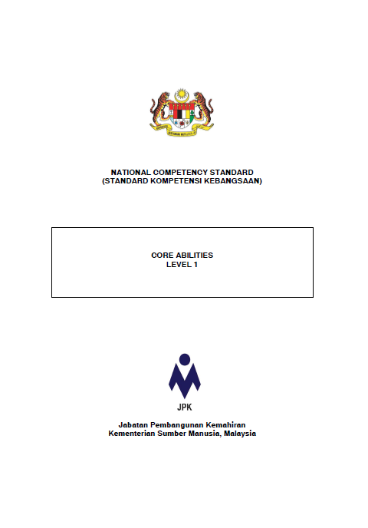
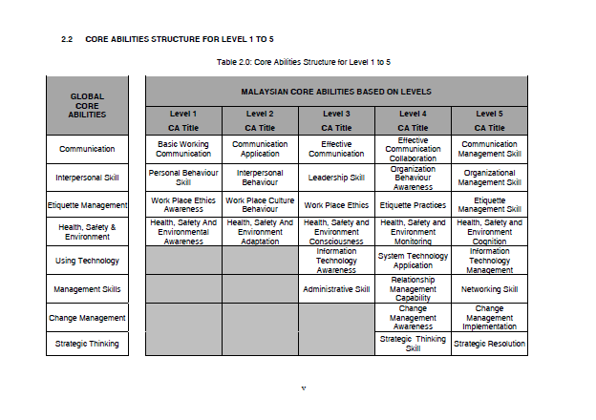
Core Abilities Structure (L1-L5)
NCS CORE ABILITIES

Slide 10
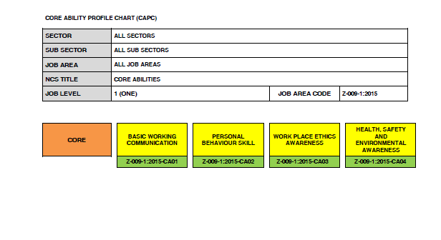
Core Ability Profile Chart
Core Ability

Slide 11
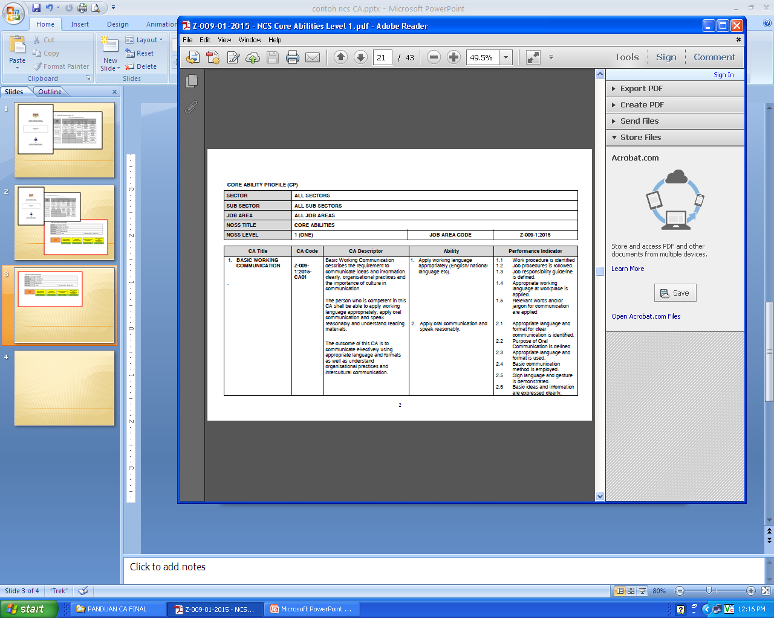

Slide 12
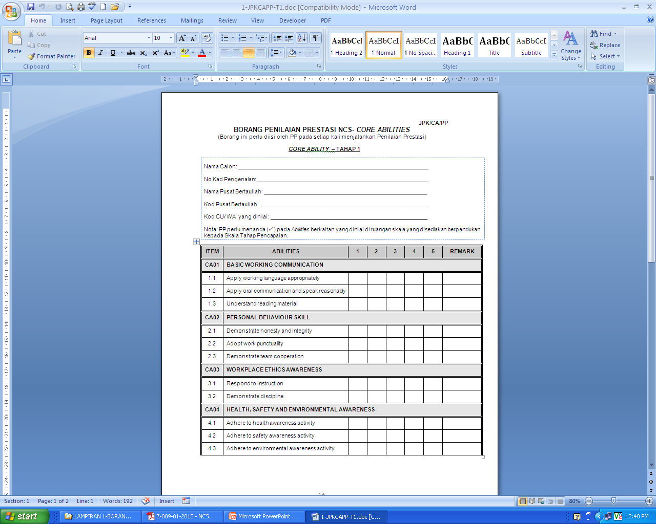

Slide 13
5.1 CORE ABILITY PROFILE CHART (CAPC) – LEVEL 1
SECTOR |  | ALL SECTORS
SUB SECTOR |  | ALL SUB SECTORS
JOB AREA |  | ALL JOB AREAS
NCS TITLE |  | CORE ABILITIES
JOB LEVEL |  | ONE (1) |  |  | JOB AREA CODE |  |  | Z:009-1:2015
CORE ABILITY |  | ABILITIES
CORE |  | BASIC WORKING COMMUNICATION |  | PERSONAL BEHAVIOUR SKILL |  |  | WORK PLACE ETHICS AWARENESS |  |  | HEALTH, SAFETY AND ENVIRONMENTAL AWARENESS
 |  | Z-009-1:2015-CA01 |  | Z-009-1:2015-CA02 |  |  | Z-009-1:2015-CA03 |  |  | Z-009-1:2015-CA04

Slide 14
5.2 KANDUNGAN CORE ABILITY – LEVEL 1
CORE ABILITY | ABILITY | TRAINING (HOURS) | TOTAL TRAINING (HOURS)
1.0 BASIC WORKING COMMUNICATION | 1.1 Apply working language appropriately (English/ national language etc). | 4 | 10
 | 1.2 Apply oral communication and speak reasonably. | 3
 | 1.3 Understand reading material. | 3
2.0 PERSONAL BEHAVIOUR SKILL | 2.1 Demonstrate honesty and integrity | 4 | 15
 | 2.2 Adopt work punctuality | 4
 | 2.3 Demonstrate team cooperation | 7
3.0 WORK PLACE ETHICS AWARENESS | 3.1 Respond to instructions | 2 | 4
 | 3.2 Demonstrate discipline at workplace | 2
4.0 HEALTH, SAFETY AND ENVIRONMENTAL AWARENESS | 4.1 Adhere to health awareness activity | 4.5 | 11
 | 4.2 Adhere to safety awareness activity | 4.0
 | 4.3 Adhere to environmental awareness activity | 2.5
TOTAL TRAINING HOURS |  | 40 | 40

Slide 15
5.3 CORE ABILITY PROFILE CHART (CAPC) – LEVEL 2
SECTOR |  | ALL SECTORS
SUB SECTOR |  | ALL SUB SECTORS
JOB AREA |  | ALL JOB AREAS
NCS TITLE |  | CORE ABILITIES
JOB LEVEL |  | TWO (2) |  |  | JOB AREA CODE |  |  | Z:009-2:2015
CORE ABILITY |  | ABILITIES
CORE |  | COMMUNICATION APPLICATION |  | INTERPERSONAL BEHAVIOUR |  |  | WORK PLACE CULTURE BEHAVIOUR |  |  | HEALTH, SAFETY AND ENVIRONMENT ADAPTATION
 |  | Z-009-2:2015-CA01 |  | Z-009-2:2015-CA02 |  |  | Z-009-2:2015-CA03 |  |  | Z-009-2:2015-CA04

Slide 16
5.4 KANDUNGAN CORE ABILITY – LEVEL 2
CORE ABILITY | ABILITY | TRAINING (HOURS) | TOTAL TRAINING (HOURS)
1.0 COMMUNICATION APPLICATION | Apply two-way communication | 2 | 10
 | Disseminate information electronically | 4
 | Disseminate information manually | 2
 | Apply information confidentiality | 2
2.0 INTERPERSONAL BEHAVIOUR | Demonstrate responsibility at workplace | 2 | 11
 | Apply teamwork cooperation concept | 4
 | Initiate problem solving at workplace | 3
 | Demonstrate work performance awareness | 2
3.0 WORKPLACE CULTURE BEHAVIOUR | Apply practice work culture | 3 | 9
 | Respond appropriately to unusual situations | 3
 | Demonstrate initiative and flexibility | 3
4.0 HEALTH, SAFETY AND ENVIRONMENT ADAPTATION | Demonstrate health compliance | 5 | 10
 | Demonstrate safety compliance | 2
 | Demonstrate environment compliance | 3
TOTAL TRAINING HOURS |  |  | 40

Slide 17
5.5 CORE ABILITY PROFILE CHART (CAPC) – LEVEL 3
SECTOR |  |  | ALL SECTORS
SUB SECTOR |  |  | ALL SUB SECTORS
JOB AREA |  |  | ALL JOB AREAS
NCS TITLE |  |  | CORE ABILITIES
JOB LEVEL |  |  | THREE (3) |  |  |  | JOB AREA CODE |  |  | Z:009-3:2015
CORE ABILITY |  |  | ABILITIES
CORE |  |  | EFFECTIVE COMMUNICATION |  | INFORMATION TECHNOLOGY AWARENESS |  |  |  | LEADERSHIP SKILL |  |  | WORK PLACE ETHICS
 |  |  | Z-009-3:2015-CA01 |  | Z-009-3:2015- CA02 |  |  |  | Z-009-3:2015-CA03 |  |  | Z-009-3:2015-CA04
 |  |  | ADMINISTRATIVE SKILL |  |  | HEALTH, SAFETY & ENVIRONMENTAL IMPLEMENTATION CONSCIOUSNESS
 |  |  | Z-009-3:2015-CA05 |  |  | Z-009-3:2015-CA06

Slide 18
5.6 KANDUNGAN CORE ABILITY – LEVEL 3
CORE ABILITY | ABILITIES | TRAINING (HOURS) | TOTAL TRAINING (HOURS)
1.0 EFFECTIVE COMMUNICATION | Demonstrate communication practice | 5 | 10
 | Apply basic negotiation skills | 5
2.0 INFORMATION TECHNOLOGY AWARENESS | Demonstrate Technology update awareness | 3 | 6
 | Demonstrate Information technology regulatory awareness | 3
3.0 LEADERSHIP SKILLS | Demonstrate counselling ability | 5 | 31
 | Demonstrate responsibility & authority | 5
 | Demonstrate teamwork ability | 5
 | Demonstrate emotional intelligence | 6
 | Apply work knowledge in identifying clients needs | 5
 | Monitor work performance delivery | 5
4.0 WORK PLACE ETHICS | Apply cultural requirement at workplace | 4.5 | 9
 | Handle situations that require attention | 4.5
5.0 ADMINISTRATIVE SKILL | Demonstrate work asset usage awareness | 4
 | Negotiate acceptance and delivery of products and/or services | 4 | 12
 | Implement workforce practices | 4
6.0 HEALTH, SAFETY & ENVIRONMENTAL CONSCIOUSNESS | Execute health consciousness | 4
 | Execute safety consciousness | 4 | 12
 | Execute environment compliance | 4
TOTAL TRAINING HOUR |  |  | 80

Slide 19
5.7 CORE ABILITY PROFILE CHART (CAPC) – LEVEL 4
SECTOR |  |  | ALL SECTORS
SUB SECTOR |  |  | ALL SUB SECTORS
JOB AREA |  |  | ALL JOB AREAS
NCS TITLE |  |  | CORE ABILITIES
JOB LEVEL |  |  | FOUR (4) |  |  |  | JOB AREA CODE |  |  | Z:009-4:2015
CORE ABILITY |  |  | ABILITIES
CORE |  |  | ORGANISATIONAL BEHAVIOUR AWARENESS |  | HEALTH, SAFETY & ENVIRONMENT MONITORING |  |  |  | RELATIONSHIP MANAGEMENT CAPABILITY |  |  | ETHIQUETTE PRACTICES
 |  |  | Z-009-4:2015-CA01 |  | Z-009-4:2015- CA02 |  |  |  | Z-009-4:2015-CA03 |  |  | Z-009-4:2015-CA04
 |  |  | STRATEGIC THINKING SKILL |  |  | EFFECTIVE COMMUNICATION COLLABORATION |  |  | CHANGE MANAGEMENT AWARENESS |  |  | INFORMATION TECHNOLOGY APPLICATION
 |  |  | Z-009-4:2015-CA05 |  |  | Z-009-4:2015-CA06 |  |  | Z-009-4:2015-CA07 |  |  | Z-009-4:2015-CA08

Slide 20
5.8 KANDUNGAN CORE ABILITY – LEVEL 4 (part 1)
CORE ABILITY | ABILITIES | TRAINING (HOURS) | TOTAL TRAINING (HOURS)
01. ORGANISATIONAL BEHAVIOUR AWARENESS | 1.Adhere to conceptual framework of the organisation | 2 | 15
 | 2.Enhance Successful Teamwork | 2
 | 3.Demonstrate work delegation capability | 3
 | 4.Ensure systematic documentation | 2
 | 5.Encourage organisation event coordination | 2
 | 6.Comply with training requirement procedure | 2
 | 7.Recognise staff potential vertical mobility | 2
02. HEALTH, SAFETY AND ENVIRONMENT (HSE) MONITORING | 1.Ensure Health awareness program activity. | 3 | 8
 | 2.Ensure Safety awareness program activity. | 3
 | 3.Ensure Environmental awareness program activity. | 2

Slide 21
5.8 KANDUNGAN CORE ABILITY – LEVEL 4 (part 2)
CORE ABILITY | ABILITIES | TRAINING (HOURS) | TOTAL TRAINING (HOURS)
03. RELATIONSHIP MANAGEMENT | 1.Promote good networking | 2 | 12
 | 2.Enhance interpersonal conflict resolution | 2
 | 3.Promote empathy | 2
 | 4.Provide Motivation | 2
 | 5.Demonstrate initiative behaviour | 2
 | 6.Adhere to continuous effective learning | 2
04. ETIQUETTE PRACTICES | 1.Adhere to codes of ethical discipline | 2 | 10
 | 2.Comply with cultural awareness. | 2
 | 3.Adhere to meticulous performance | 2
 | 4.Adhere to result oriented practice | 2
 | 5.Adhere to protocol requirements | 2
05. STRATEGIC THINKING SKILL | 1.Advocate effective thinking | 2 | 10
 | 2.Comply with effective analysis | 2
 | 3.Apply stress management techniques | 2
 | 4.Apply budgetary control practices | 2
 | 5.Apply problem solving techniques | 2

Slide 22
5.8 KANDUNGAN CORE ABILITY – LEVEL 4 (part 3)
CORE ABILITY | ABILITIES | TRAINING (HOURS) | TOTAL TRAINING (HOURS)
06. EFFECTIVE COMMUNICATION COLLABORATION | 1.Apply effective communication | 2 | 6
 | 2.Formulate constructive presentation speech | 2
 | 3.Adhere to effective presentation methodology | 2
07. CHANGE MANAGEMENT AWARENESS | 1.Adhere to change management objective | 2 | 11
 | 2.Observe to change management methodology | 2
 | 3.Adhere to change management initiative | 3
 | 4.Adhere to coaching and mentoring implementation | 2
 | 5.Enhance organisation branding | 2
08. SYSTEM TECHNOLOGY APPLICATION | 1.Adopt appropriate software application | 2 | 8
 | 2.Comply to system analysis application | 2
 | 3.Update IT application | 2
 | 4.Adhere to IT rules and regulation | 2
TOTAL TRAINING HOUR |  |  | 80

Slide 23
5.9 CORE ABILITY PROFILE CHART (CAPC) – LEVEL 5
SECTOR |  |  | ALL SECTORS
SUB SECTOR |  |  | ALL SUB SECTORS
JOB AREA |  |  | ALL JOB AREAS
NCS TITLE |  |  | CORE ABILITIES
JOB LEVEL |  |  | FIVE (5) |  |  |  | JOB AREA CODE |  |  | Z:009-5:2015
CORE ABILITY |  |  | ABILITIES
CORE |  |  | ORGANISATIONAL MANAGEMENT SKILLS |  | HEALTH, SAFETY & ENVIRONMENT COGNITION |  |  |  | NETWORKING SKILLS |  |  | ETHIQUETTE MANAGEMENT SKILLS
 |  |  | Z-009-5:2015-CA01 |  | Z-009-5:2015- CA02 |  |  |  | Z-009-5:2015-CA03 |  |  | Z-009-5:2015-CA04
 |  |  | STRATEGIC RESOLUTION |  |  | COMMUNICATION MANAGEMENT SKILLS |  |  | CHANGE MANAGEMENT IMPLEMENTATION |  |  | INFORMATION TECHNOLOGY MANAGEMENT
 |  |  | Z-009-5:2015-CA05 |  |  | Z-009-5:2015-CA06 |  |  | Z-009-5:2015-CA07 |  |  | Z-009-5:2015-CA08

Slide 24
5.10 KANDUNGAN CORE ABILITY – LEVEL 5 (part 1)
CORE ABILITY | ABILITIES | TRAINING (HOURS) | TOTAL TRAINING (HOURS)
1.0 ORGANISATIONAL MANAGEMENT SKILLS | 1.Enhance good leadership manners. | 2 | 16
 | 2.Observe Organizational behaviour. | 2
 | 3.Cognise emotional intelligence. | 2
 | 4.Adopt empowerment practices. | 2
 | 5.Demonstrate excellent organisation image. | 2
 | 6.Adopt appraisal systems. | 2
 | 7.Apply business analysis concepts. | 2
 | 8.Demonstrate professional personal appearance. | 2
2.0 HEALTH, SAFETY AND ENVIRONMENT COGNITION | 1.Monitor Health awareness program | 2.5 | 10
 | 2.Monitor Safety awareness program | 2.5
 | 3.Monitor Environmental awareness program | 2.5
 | 4.Comply with challenges and environment sensitivity program. | 2.5

Slide 25
5.10 KANDUNGAN CORE ABILITY – LEVEL 5 (part 2)
CORE ABILITY | ABILITIES | TRAINING (HOURS) | TOTAL TRAINING (HOURS)
3.0 NETWORKING SKILLS | 1.Communicate to relevant parties. | 2 | 6
 | 2.Establish networking. | 2
 | 3.Identify applicable parties./ Establish self-confidence. | 2
4.0 ETIQUETTE MANAGEMENT SKILLS | 1.Implement code of ethics. | 2 | 10
 | 2.Adhere to cultural awareness. | 2
 | 3.Sustain meticulous performance. | 2
 | 4.Sustain result oriented practices. | 2
 | 5.Implement work place integrity. | 2
5.0 STRATEGIC RESOLUTION | 1.Classify stress management application. | 2 | 10
 | 2.Observe budgetary control procedure. | 2
 | 3.Solicit counselling. | 2
 | 4.Apply mentoring techniques. | 2
 | 5.Apply strategic resolution techniques. | 2

Slide 26
5.10 KANDUNGAN CORE ABILITY – LEVEL 5 (part 5)
CORE ABILITY | ABILITIES | TRAINING (HOURS) | TOTAL TRAINING (HOURS)
6.0 COMMUNICATION MANAGEMENT | 1. Deliver effective multiple communication presentation techniques. | 2 | 10
 | 2. Promote constructive presentation speech. | 2
 | 3.Comply with skilful approach methodology. | 2
 | 4.Implement communication strategies. | 2
 | 5.Review communication results. | 2
7.0 CHANGE MANAGEMENT IMPLEMENTATION | 1.Enhance change management objective. | 2 | 12
 | 2.Advocate Change Management Methodology. | 2
 | 3.Sustain change management initiative. | 2
 | 4.Ensure coaching and mentoring implementation. | 2
 | 5.Resolve criticism. | 2
 | 6.Promote organisation branding. | 2
8.0 INFORMATION TECHNOLOGY MANAGEMENT | 1.Manage appropriate software application. | 2 | 6
 | 2.Manage system analysis application. | 2
 | 3.Manage IT application. | 2
TOTAL TRAINING HOUR |  |  | 80

Slide 27
6.0 APA ITU CORE ABILITIES (What is Core Abilities)
Core Abilities adalah kemahiran generik bagi pembentukan peribadi dan pekerti seseorang insan/pelajar/pekerja bagi melengkapkan kemahiran fizikal untuk memajukan diri sebagai individu dan warganegara
(Transportable skill that are essential for success in life)

Slide 28
7.0 PERBEZAAN DIANTARA KETERAMPILAN DENGAN CORE ABILITIES
(Different between Competencies and Core Abilities)
Keterampilan menerangkan kemahiran utama yang diperlukan untuk melaksanakan tugas dengan cekap dan berkesan dan terdiri daripada pengetahuan, kemahiran dan sikap.
(Competency describes a major skill needed to perform a task effectively and efficiently and consist of knowledge , skill and attitude)

Slide 29
7.0 PERBEZAAN DIANTARA KETERAMPILAN DENGAN CORE ABILITIES
(Different between Competencies and Core Abilities)
Core Abilities adalah kemahiran yang lebih luas yang melangkawi untuk pelbagai bidang dan pekerjaan.
Core ability are broader skills that run through courses and is cross functional to many disciplines and occupation

Slide 30

8.0 Soft Skill Vs Hard Skill
Soft Skills | Hard Skills
Sometimes called ‘character skills” | Technical skills & academic skills
Ability to interact and communicate positively with others | Specific skills, task or job oriented
Relates attitudes and outlooks on life | Observable
Learned as we grow up | Measureable by performance, test or quizzes
Often not directly taught in schools | Directly taught in schools
Difficult to explain; but we know when we see effective “soft skills” | Easy to define

Slide 31
9.0 KEPENTINGAN CORE ABILITIES KEPADA INDUSTRI
Kebolehan teras (core ability) adalah pelengkap pembentukan pelajar kemahiran yang berjaya
Elemen penting kebolehpasaran pelajar adalah kemampuan kemahiran teras
Mewujudkan tenaga kerja mahir yang bersahsiah tinggi
Membantu organisasi, negeri dan negara menjadi negara maju yang mampan
Menjadi manusia/warga negara yang berguna kepada agama, bangsa dan negaranya

Slide 32
10.0 CIRI-CIRI SKK CORE ABILITIES
  Peningkatan dalam pemikiran.
    CORE ABILITIES melatih calon mengaplikasi pengetahuan dan kemahiran dalam pelbagai konteks.
    CORE ABILITIES adalah proses kerana ia memerlukan pelatih:
    menentukan tujuan (determine a purpose)
    membangun strategi (develop strategies)
    melaksana strategi (Implement strategies)
    menilai proses dan hasil (evaluate outcome and process)

Slide 33
10.0 CIRI-CIRI NCS CORE ABILITIES
  Berhubung kait.
  CORE ABILITIES berkaitan antara satu sama lain walaupun ia nampak berasingan, secara praktisnya ia berkaitan. Satu-satu task atau aktiviti latihan akan melibatkan beberapa abilities.
  CORE ABILITIES boleh diajar dan dipelajari.
  Ia wujud secara bersama dalam kurikulum latihan.
Jelas
  CORE ABILITIES perlu dijelaskan dalam falsafah kursus, tujuan module dan tujuan pembelajran termasuk dalam kaedah penilaian.
Sepanjang hayat
  Pembelajaran CORE ABILITIES adalah proses pembelajaran sepanjang hayat.

Slide 34
11.0 MENGAPA PENTINGNYA NCS CORE ABILITIES ?
Apakah harapan seorang pengajar bila mengendalikan satu satu latihan …
Pelatih akan memperolehi …
  PENGETAHUAN
  KEMAHIRAN (TEKNIKAL)
  MENYEDIAKAN PELATIH UNTUK PASARAN KERJA

Slide 35
11.0 MENGAPA PENTINGNYA SKK CORE ABILITIES ?
Menghubungkan alam latihan dengan alam pekerjaan.
  pelatih boleh mengaitkan antara kemahiran spesifik dan Kemahiran yang lebih luas.
  penting untuk pembelajaran sepanjang hayat.
Secara umum pentingnya CORE ABILITIES kerana ia menyediakan:
“pengetahuan, kemahiran dan kefahaman, DAN keupayaan menggunakannya secara kritikal, kreatif dalam pelbagai konteks”

Slide 36
12.0 KAEDAH PELAKSANAAN SKK CORE ABILITIES
Perkara Am:
    Wajib bagi semua program persijilan SKM, DKM dan DLKM melalui Pusat Bertauliah.
    Pelaksanaan SKK Core Abilities hendaklah bermula dari Tahap 1 bagi semua program SKPK sama ada yang bermula dari Tahap 1 atau pun tidak.
    Tidak terpakai bagi program-program SKK yang lain.

Slide 37
12.0 KAEDAH PELAKSANAAN SKK CORE ABILITIES
Tempoh Latihan:
    Pelaksanaan latihan teori hendaklah dilaksanakan secara berasingan dan tempoh latihan termasuk di dalam tempoh latihan program SKPK.
    Latihan amali bagi Core Abilities dan program SKPK hendaklah dilaksanakan bersekali dan tempoh latihan adalah terangkum dalam tempoh latihan program SKPK.
Tahap | Tempoh latihan teori minimum
1 | 40 jam
2 | 40 jam
3 | 80 jam
4 | 80 jam
5 | 80 jam

Slide 38
12.0 KAEDAH PELAKSANAAN SKK CORE ABILITIES
Pengajar:
    Program SKK CORE ABILITIES boleh diajar oleh PP sedia ada atau TP yang dilantik oleh PB.
    PP sedia ada atau TP yang dilantik hendaklah berpengetahuan dan berpengalaman dalam Unit Kemahiran (Ability Unit) yang berkaitan.
    PP boleh mengajar dan menilai komponen teori dan amali.
    TP hanya dibenarkan untuk mengajar dan menilai komponen teori sahaja.

Slide 39
12.0 KAEDAH PELAKSANAAN SKK CORE ABILITIES
Penyampaian latihan TEORI:
    Pengajaran dan pembelajaran teori :
    Dilaksanakan di peringkat permulaan latihan mengikut tahap program SKPK yang dijalankan dan secara berasingan.
    Persijilan Tahap Tunggal (tidak mengikut tahap) dilaksanakan di permulaan program bagi semua tahap mengikut kumpulan program (band) berkenaan.

Slide 40
12.0 KAEDAH PELAKSANAAN SKK CORE ABILITIES
Penyampaian latihan AMALI:
    Pengajaran dan pembelajaran amali hendaklah dilaksanakan secara terangkum dengan program SKPK berkenaan.
    PB hendaklah memastikan semua Kemahiran (Abilities) dinilai dalam tempoh pembelajaran SKPK.
    PB hendaklah membuat pemetaan (mapping) bagi menghasilkan Matriks Core Abilities (Abilities vs CU/Modul program SKPK).

Slide 41
12.0 KAEDAH PELAKSANAAN SKK CORE ABILITIES
Penilaian Pengetahuan:
      Dilaksanakan secara berasingan di awal latihan sebelum pelatih mula menjalani latihan program SKPK.
      Dilaksanakan oleh PP atau TP yang dilantik oleh PB sahaja.
      PB hendaklah menyediakan Kertas Penilaian Pengetahuan dan skema jawapan bagi setiap CA untuk setiap tahap SKK Core Abilities.
      Tempoh masa untuk menjalankan penilaian pengetahuan bagi setiap CA adalah 30 minit yang melibatkan 20 soalan berbentuk objektif.
      Markah lulus minimum bagi setiap CA adalah 60%. Pelajar yang gagal hendaklah menjalani penilaian semula dan perlu lulus semua CA sebelum verifikasi luaran program SKPK.

Slide 42
12.0 KAEDAH PELAKSANAAN SKK CORE ABILITIES
Penilaian Prestasi:
      Dilaksanakan secara berterusan dan bersekali dengan Penilaian Prestasi program SKPK.
      Keputusan penilaian direkodkan menggunakan BORANG PENILAIAN PRESTASI SKK CORE ABILITIES berpandukan Skala Tahap Pencapaian dan mengikut tahap.
      Pemilihan kemahiran yang terlibat berpandukan kepada Matriks CORE ABILITIES.

Slide 43
12.0 KAEDAH PELAKSANAAN SKK CORE ABILITIES
Penilaian Prestasi:
      Pelatih hendaklah mencapai sekurang-kurangnya skala tahap pencapaian 3 bagi Ability yang dinilai.
      Pelatih dikehendaki mengulang Ability yang belum lulus dalam modul SKPK berikutnya.
      Jika Ability berkenaan tidak wujud pada modul berikutnya pelatih dikehendaki mengulang penilaian modul SKPK berkenaan.
      Pelatih hendaklah lulus semua Ability sebelum layak menduduki verifikasi luaran program SKPK.

Slide 44
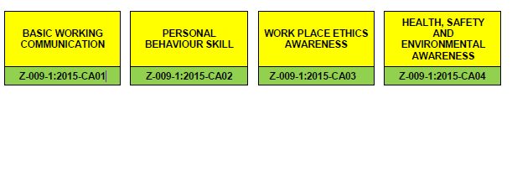
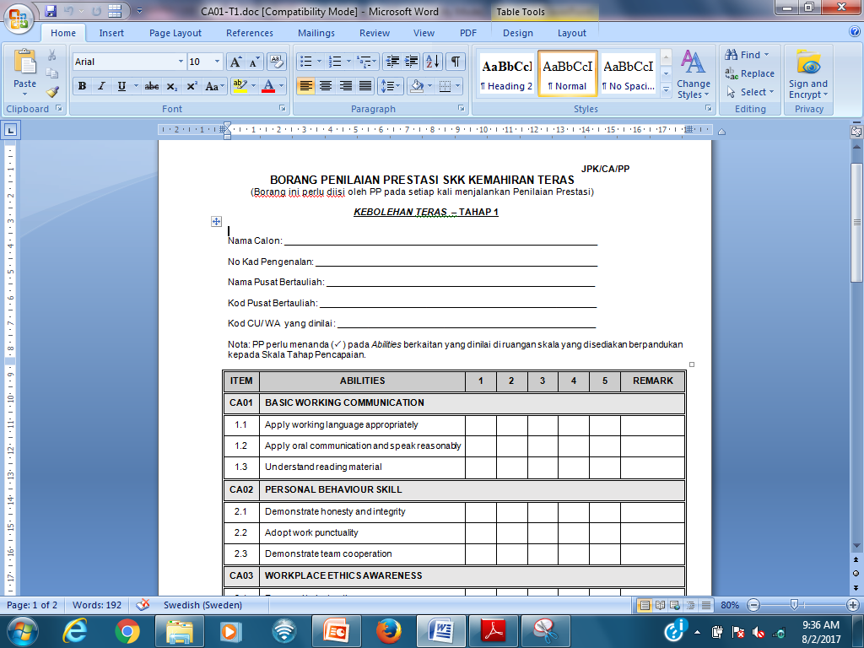
12.0 KAEDAH PELAKSANAAN SKK CORE ABILITIES
Syarat lulus penilaian Core Abilities :
  Penilaian Pengetahuan : mendapat markah minimum 60% bagi setiap CA; dan
  Penilaian Prestasi : mendapat keputusan minimum Skala 3 bagi setiap Ability pada Borang Penilaian Prestasi NCS-Core Abilities.

Slide 45
Susunan kandungan Rekod Bukti Pencapaian
      Program biasa dan persijilan tahap tunggal mengikut tahap:
  Carta Profil Kompetensi / Competency Profile Chart (CPC) bagi program SKPK sedia ada;
  Carta Profil SKK Core Abilities Z-009:2015;
  Laluan latihan (Training pathway) program SKPK;
  Matriks Core Abilities (Abilities vs CU/Modul program SKPK berkaitan);
  Rekod Pencapaian Kumulatif (RPK) bagi program SKPK sedia ada;
  Bukti-bukti pencapaian bagi semua aktiviti kerja (work activities) mengikut CU/Modul;
  Borang Penilaian Prestasi SKK Core Abilities (JPK/CA/PP) mengikut tahap yang telah dinilai berdasarkan CU/Modul
  Rekod Pencapaian Kumulatif (RPK) bagi Core Abilities komponen teori;
  Bukti Penilaian teori setiap CA;
  Keputusan Pencapaian Penilaian Prestasi NCS-Core Ability (JPK/CA/KPPP);

Slide 46
Susunan kandungan Rekod Bukti Pencapaian
      Persijilan tahap tunggal tidak mengikut tahap:
      Fail Induk:
Carta Profil Kompetensi / Competency Profile Chart (CPC) bagi program SKPK sedia ada;
Carta Profil SKK Core Abilities Z-009:2015;
Laluan latihan (Training pathway) program SKPK;
Matriks Core Abilities (Abilities vs CU/Modul program SKPK berkaitan);
Rekod Pencapaian Kumulatif (RPK) bagi program SKPK sedia ada;
Bukti-bukti pencapaian bagi semua aktiviti kerja (work activities) mengikut CU/Modul;
Borang Penilaian Prestasi SKK Core Abilities (JPK/CA/PP) mengikut tahap yang telah dinilai berdasarkan CU/Modul
        Fail Core Abilities Pengetahuan:
a) Rekod Pencapaian Kumulatif (RPK) bagi Core Abilities komponen teori;
Bukti penilaian teori setiap CA;
Keputusan Pencapaian Penilaian Prestasi NCS-Core Ability (JPK/CA/KPPP);

Slide 47
12.0 KAEDAH PELAKSANAAN SKK CORE ABILITIES
Kurikulum:
  PB hendaklah menyediakan kurikulum berdasarkan SKK Core Abilities yang merangkumi perkara berikut:
  Kertas Penerangan
  Kertas Tugasan
  Jadual pelaksanaan latihan SKK Core Abilities;
  Dokumen Penilaian
        Penilaian Pengetahuan

Slide 48
12.0 KAEDAH PELAKSANAAN SKK CORE ABILITIES
Kurikulum:
      Bahan Pembelajaran Bertulis bagi Core Abilities boleh didapati di JPK dan digunakan sebagai rujukan dan panduan untuk PB melaksanakan latihan. Walaubagaimana pun PB digalakkan membangunkan Bahan Pembelajaran Bertulis sendiri yang bersesuaian dengan program SKPK yang ditawarkan kepada pelatih.

Slide 49
12.0 KAEDAH PELAKSANAAN SKK CORE ABILITIES
Jaminan Kualiti:
  PB hendaklah memastikan kandungan kurikulum merujuk dan memenuhi kepada keperluan SKK Core Abilities.
  Penilaian Pengetahuan Core Abilities boleh dibuat oleh PP / TP yang dilantik oleh PB manakala Penilaian Prestasi Core Abilities hendaklah dijalankan oleh PP yang dilantik program SKPK yang berkaitan.
  PPD mengurus, memantau dan mengawal selia pelaksanaan latihan yang dinilai oleh PP/TP.
  Verifikasi luaran bagi program SKK Core Abilities akan dilaksanakan oleh PPL yang dilantik oleh JPK bertujuan untuk menyemak bukti- bukti penilaian yang dilakukan oleh PP/TP dan PPD serta mengesahkan RPK.

Slide 50
12.0 KAEDAH PELAKSANAAN SKK CORE ABILITIES
Syarat Persijilan:
  Pelatih wajib LULUS SKK Core Abilities yang merupakan salah satu syarat untuk penganugerahan SKM, DKM dan DLKM.
  Bagi program SKPK sama ada yang bermula dari Tahap 1 atau pun tidak, pelaksanaan SKK Core Abilities hendaklah bermula dari Tahap 1*.
* Contoh 1:
Program “Servis Pembaikan - Kenderaan Ringan” (TP-300-2:2016) yang bermula dengan Tahap 2, perlu mengikuti Core Abilities bagi Tahap 1 dan Tahap 2
* Contoh 2:
Program “Inovasi Dan Pembangunan Rekabentuk Produk” (MC-095-4:2016) yang bermula dengan Tahap 4, perlu mengikuti Core Abilities bagi Tahap 1, Tahap 2, Tahap 3 dan Tahap 4

Slide 51
TARIKH KUATKUASA
  Panduan Perlaksanaan Standard Kompetensi Kebangsaan (SKK) – Core Abilities (Pindaan 2015) berkuatkuasa mulai 01 JULAI 2017.

Slide 52
SESI SOAL JAWAB

Slide 53
SEKIAN TERIMA KASIH

